Slide 1
SWE-4805: Software Verification and Validation
Introduction
Md. Nazmul Haque
Lecturer, IUT
Department of Computer Science and Engineering
Islamic University of Technology
December 02, 2021

Slide 2
SRS
Requirement Specification
Permission management system
There are three kinds of things in it such as Accounts, Resources and Users.
Resources and Users belong to Accounts.
Users can have direct access to Resources.
Users can have a parent Resource.
If a User can access a parent Resource, then s/he gets access to any child Resource.

Slide 3
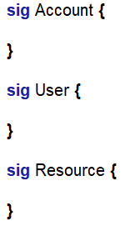

Alloy
Permission Management System: Signatures

Slide 4
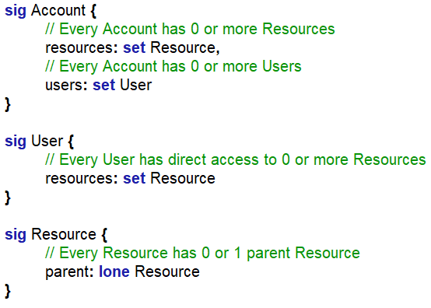
Alloy
Permission Management System: Fields (Relations)

Slide 5
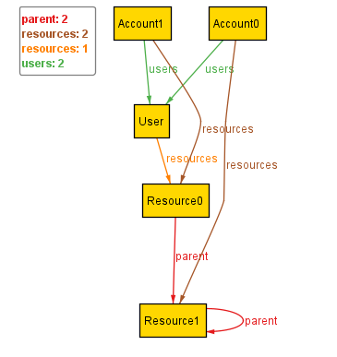
Alloy
Permission Management System
Instance
For every user, there is exactly one account.

Slide 6
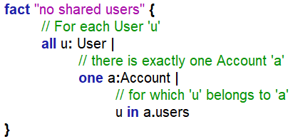
Alloy
Permission Management System
User belong to one account

Slide 7
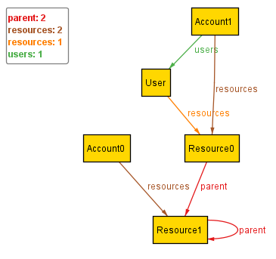
Alloy
Permission Management System
Instance
Resource sharing: CONFLICT

Slide 8
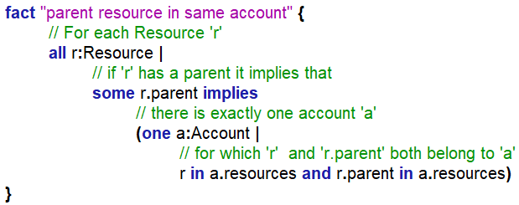
Alloy
Permission Management System

Slide 9
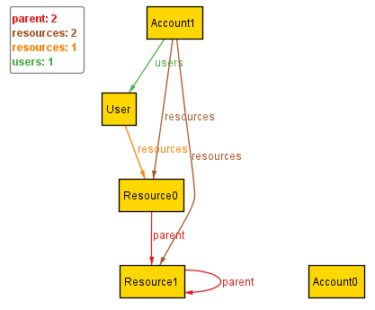
Alloy
Permission Management System
Instance
CYCLE

Slide 10
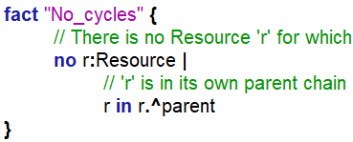
Alloy
Permission Management System

Slide 11
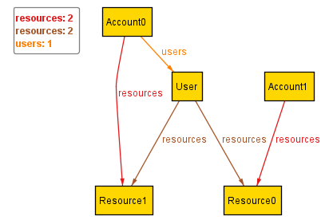
Alloy
Permission Management System
Instance
User shouldn’t have access to another account’s resources

Slide 12
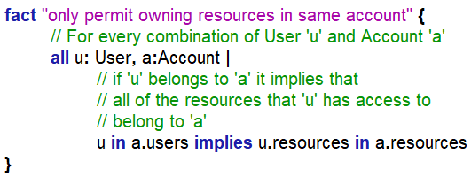
Alloy
Permission Management System

Slide 13
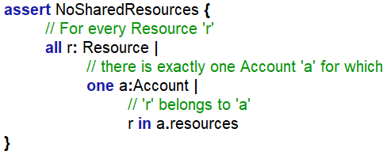

Alloy
Permission Management System

Slide 14
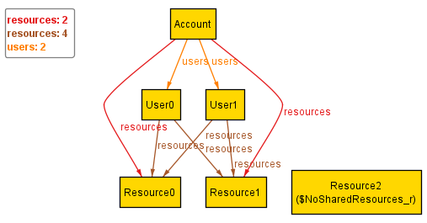
Alloy
Permission Management System
Instance
Believe: Every resource belongs to exactly one account
Every Resource should have an account

Slide 15
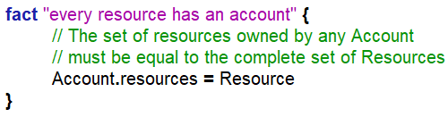
Alloy
Permission Management System

Slide 16
Alloy
Permission Management System

Slide 17
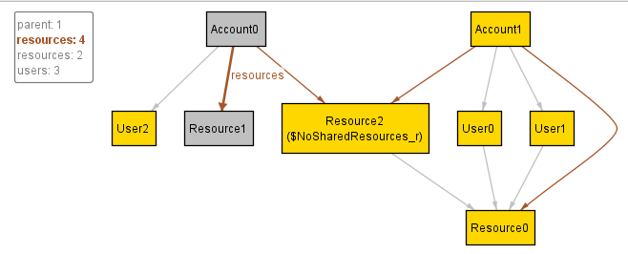
Alloy
Permission Management System
Instance
Believe: Every resource belongs to exactly one account
Resource2 is shared with Account0 and Account1

Slide 18
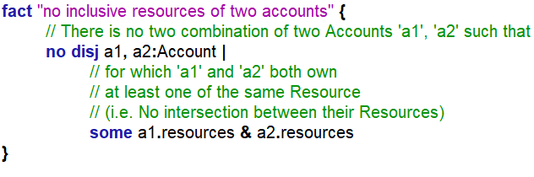
Alloy
Permission Management System
No counterexample found.

Slide 19
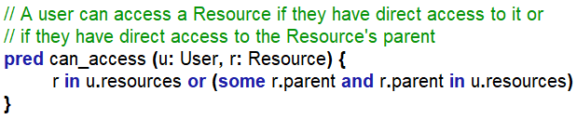
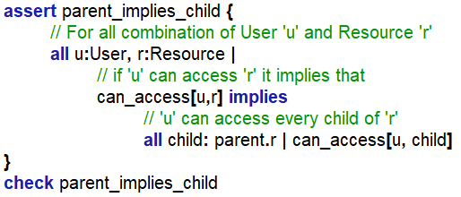
Alloy
Permission Management System

Slide 20
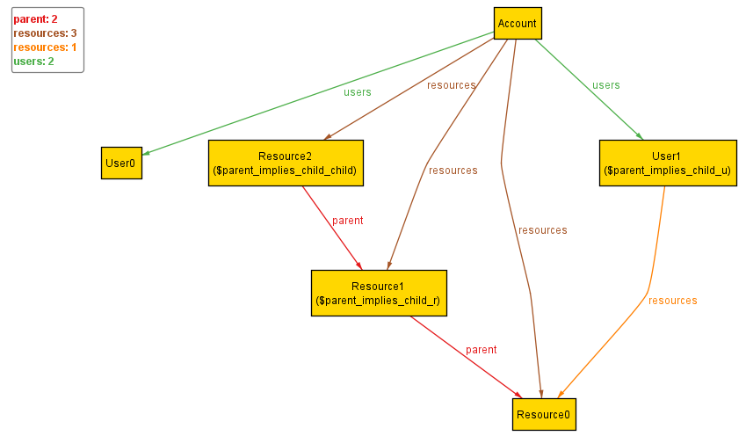
Alloy
Permission Management System
Instance

Slide 21
ANY QUESTION ?
THANK YOU !

Slide 22
Acknowledgements
Acknowledgements
[1] Marcus S. Fisher, Software Verification and Validation: An Engineering and Scientific Approach, Springer, 2007 edition, 2006.
[2] Chauhan, Naresh. Software Testing: Principles and Practices. Oxford university press, 2010.
[3] Department of Software Engineering, University of Iowa.

